Slide 1
AMERICAN-CHACO REGION PROGRAM
WOMEN FROM THE SOUTH’S FUND

Slide 2
Key Program’S POINTS
Support Women Groups from Grassroots Communities
Support organezed by Eco-Región
Support an uneven dispute for territory.

Slide 3
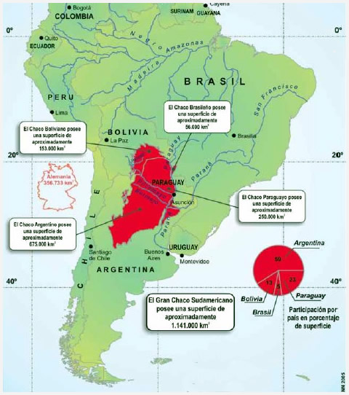
CHACO AMÉRICANO

Slide 4
Women from the grassroots communities become natural leaders
The most affected
Their position as caretakers
Isolation
Criminalization of the leaders
Indigenous world view

Slide 5
Reflections and Learning from the first Year
Territory point of view
The alliance with environmental organizations
Peasant and Guaraní culture

